Slide 1
Apriori Algorithm
IT-494

Slide 2
Aditya Shah - 202003045
Guide :
Professor PM Jat
TA - Vinay Sheth

Slide 3
Previously I have observed that,
How can I find a frequent itemset from all possible candidate itemsets. Normally by comparing them with support value I can say whether or not this candidate set is frequent. But due to so many needless computations I tried to make this algorithm more efficient. To do so I used pruning and the new algorithm I got was ‘apriori algorithm’. After that I have seen implementation of apriori algorithm, sequential and map-reduce. Then I saw pros and cons of these algorithms. Then I saw YAFIM algorithm which is implemented in spark. After that I directly saw which algorithm is faster betIen MRApriori and YAFIM but I have not yet implemented it in code. Now in this presentation I will try to implement this algorithm through code and see what I derived was true or not ?

Slide 4
Objective
Our main aim is that from a given itemset I want to find the frequent itemset.
To do so I will first see all the three algorithms and see it’s implementation through code. Then I will see implementation insights, which dataset I used to do the following task, our analysis of what I achieved after comparing these algorithms and finally results.
This will be our roadmap for the following presentation:
Sequential Code
Map Reduce Code
Spark Code (YAFIM)
Analysis
Results
Conclusion

Slide 5
Implementation of algorithm (Sequential)
|
|
|
|
|
|
|
|
|
|
|
|
|
|
|
for each c in C_k:
for each t in TID:
If ( c belongs to t ):
Count[c] += 1
If ( Count[c] >= min_sup ):
FIL_k += c
k += 1
}
-FIL_1 = Frequent itemset of 1 length
k = 2
-while ( FIL_k != 0 ):
{
C_k = {a + b | a belongs to FIL_1(k-1)
& b belongs to FIL_1(k-1) & their
k-2 items should be identical }

Slide 6
Implementation of algorithm (MRApriori)
PHASE 1: For 1 length Frequent Itemset
|
|
|
|
|
|
|
|
|
|
|
|
|
|
|
MAPPER (key (C_No) , value (row)) :
-Read TID
-for each t in TID:
Output( t , 1 )
REDUCER (key (c) , value (list of 1's)) :
-sup = 0
for each v in value (list of 1’s ):
sup +=1
if(sup >= min_sup)
Output( c(itemset) , sup )

Slide 7
PHASE 2: For k length Frequent Itemset
|
|
|
|
|
|
|
|
|
|
|
|
|
|
|
MAPPER (key (C_No) , value (row)) :
-Read TID ( using mapper_init )
-Read L_k-1 Frequent Itemset List ( using mapper_init )
-C_k = {a + b | a belongs to FIL_1(k-1)
& b belongs to FIL_1(k-1) &
k-2 items should be identical }
-for each c in C_k:
for each t in TID:
if( c belongs to t)
Output( c(itemset) , 1 )
REDUCER (key (c) , value (list of 1's)) :
-sup = 0
for each v in value( list of 1’s ):
sup +=1
if(sup >= min_sup)
Output( c(itemset) , sup )

Slide 8
Implementation of algorithm (YAFIM)
PHASE 1: For 1 length
Frequent Itemset
|
|
|
|
|
|
|
|
|
|
|
|
|
|
|
PHASE 2: For k length Frequent Itemset
-for each t in TID:
for each i in t:
map( i , 1 )
-ReduceByKey( i , count )
-for each i :
Sum += count
-If ( Sum >= min_sup ):
Output( i , sum )
|
|
|
|
|
|
|
|
|
|
|
|
|
|
|
- C_k = {a + b | a belongs to FIL_1(k-1)
& b belongs to FIL_1(k-1) &
k-2 items should be identical }
- for each c in C_k:
for each t in TID:
If ( c belongs to t )
map( c , 1 )
-ReduceByKey( c , count )
-for each c (key) :
while( count (value) != 0 )
Sum += count
-If ( Sum >= min_sup ):
Output( i , sum )

Slide 9
Implementation Insight
Main method to create k length candidate itemset from two (k-1) length candidate itemsets is:
All items in the candidate itemset should be in lexicographic order.
First (k-2) items in the (k-1) length candidate itemsets should be the same then I can join those two itemsets.
I have successfully implemented sequential algorithm in python(I have used numpy and pandas library for it).
I could only implement map reduce upto 1 length candidate itemset(Because it is difficult to generate candidate set, it requires accessing two items at the same time(for 2 length candidate set) and same for 3,4 and so on, and also it is difficult to remove duplicates. Also noise was coming into).
I have implemented spark/YAFIM completely.
I have done the testing on cloud server(Google colab).
RAM used in the execution of the code in the cloud is 1.35 GB.

Slide 10
Dataset
I have used the MushRoom dataset for this algorithm to do our observations and analysis.
Using this dataset it will increase computationality and for that I have to convert the dataset.
So I have converted our dataset into binary form which will make our operations easier to do. This dataset is Transactional dataset.
I have converted each attribute of our dataset into an item, this will make 119 items and 8124 transactions.

Slide 11
ANALYSIS:
I can see that how YAFIM is on an average 41 times faster than normal Sequential Algorithm in a normal case
In the case where the size of the dataset is doubled YAFIM is almost 39 times faster than Sequential Algorithm.
The results cannot be compared to the results of the paper because , in the paper the comparison was of MRApriori and YAFIM , also the system setup is different
I have implemented the same code with same dataset 5 times as the execution time changes every time . This is because I are running the code using cloud server.
The execution times plotted is the average taken of the five readings
I can see that YAFIM is almost 2 times faster than MRApriori

Slide 12
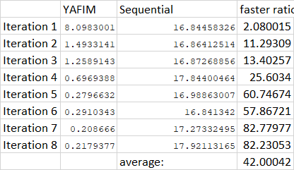

Slide 13
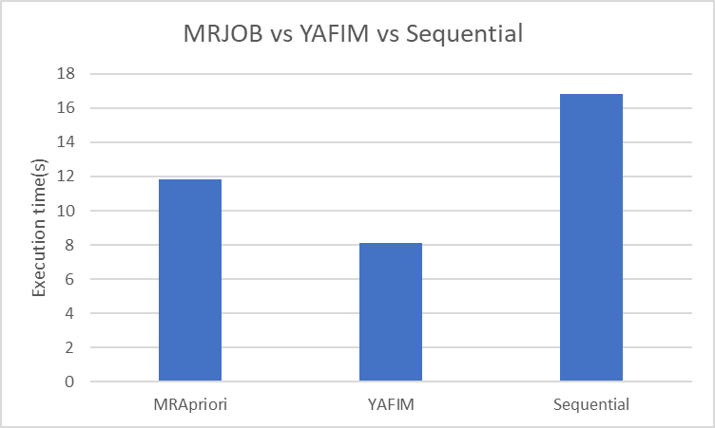
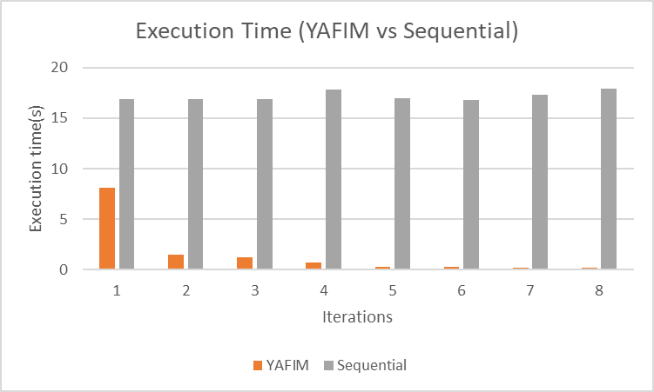
RESULTS
Iteration 1
All Iterations

Slide 14
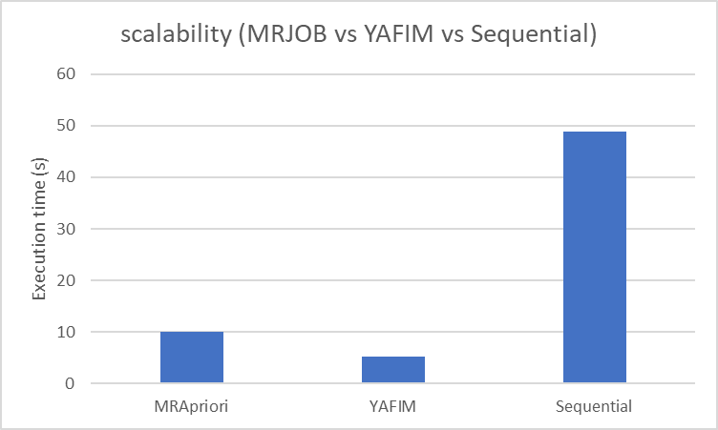
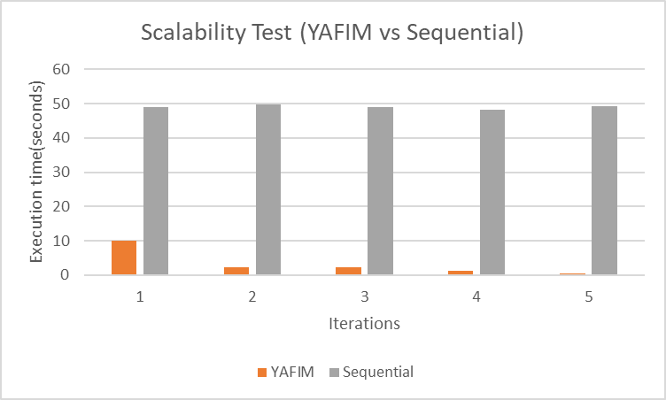
Scalability Test:
Iteration 1
All Iterations

Slide 15
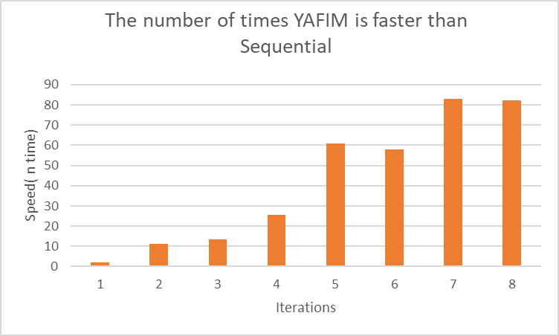

Slide 16
Conclusion
In conclusion, I have learnt what is the apriori algorithm and why I should use them and what is the practical use of it in real application(Ex. Market basket data).
I have also learnt that I can use it in parallel to divide the comparison operation of candidate itemset and transaction set and hence can reduce the time complexity, so I learnt how to implement apriori algorithm in map reduce and spark(YAFIM).
I can also use some other techniques in this algorithm like “Hash table” and “Hash Tree” to reduce the space and time complexity further.
By all these analysis, I can say that YAFIM Apriori is very much better than Map Reduce Apriori and Sequential Algorithm.

Slide 17
Reference
Reference Paper:
Qiu, Hongjian, et al. "Yafim: a parallel frequent itemset mining algorithm with spark." 2014 IEEE International Parallel & Distributed Processing Symposium Workshops. IEEE, 2014.

Slide 18
Thank you

